Slide 1


No Time? No Line!

Slide 2
$300 000 ~ 30% Stake

Slide 3
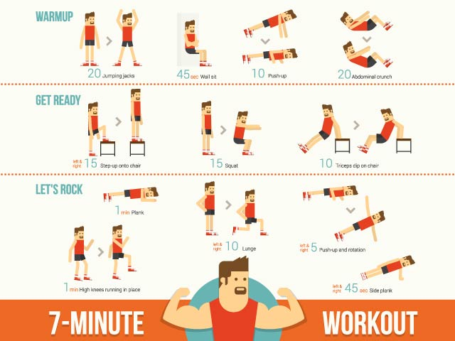




What can we do in 10 - 15 mins?

Slide 4


Slide 5
75 mins a week
300 mins a month
3600 mins a year
60 HOURS!

Slide 6
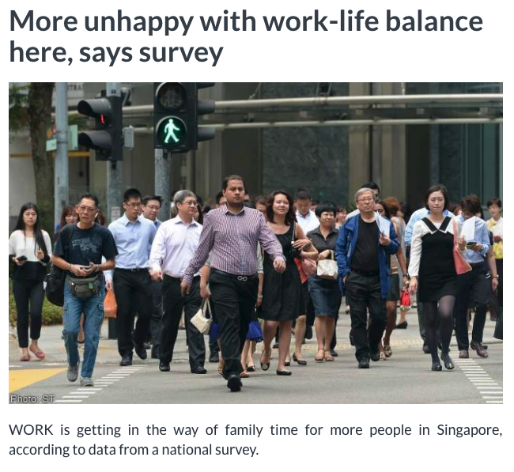
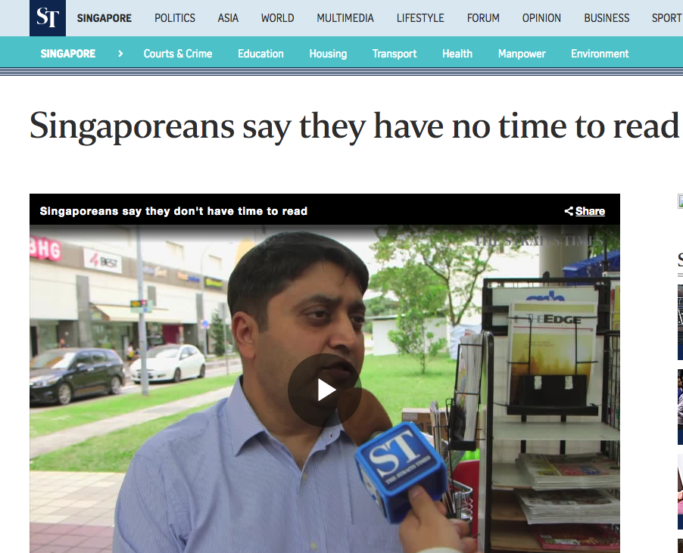
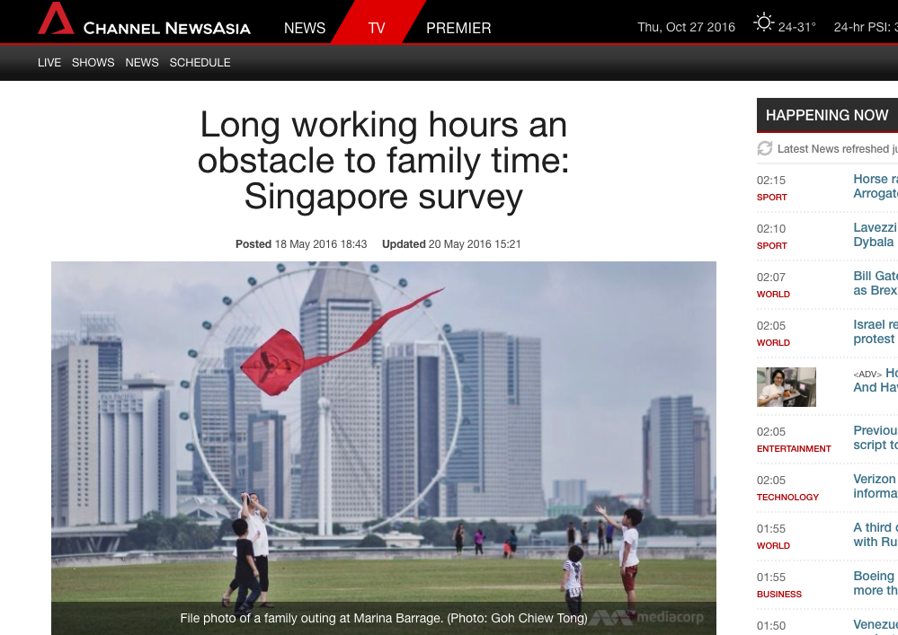
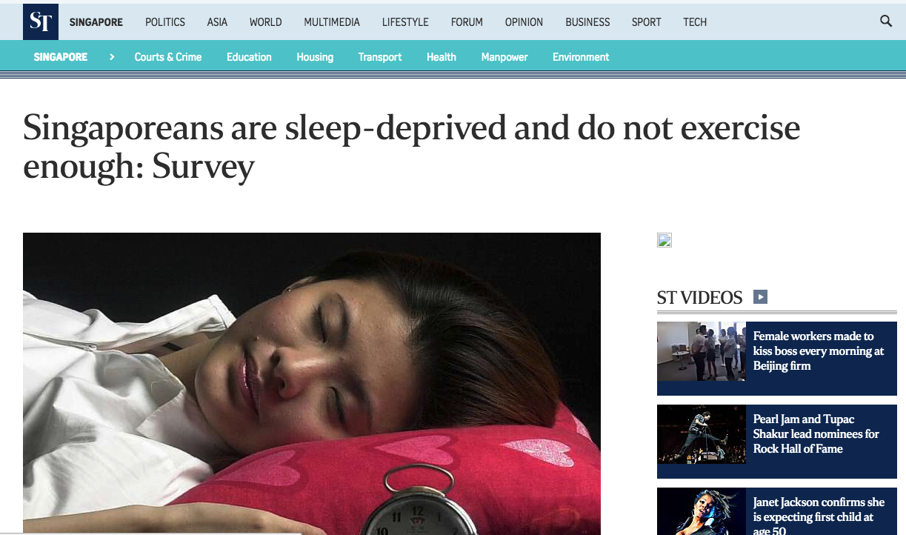
Time Is Affecting Our Lives

Slide 7

We are starving for more time, help us Sharks!

Slide 8
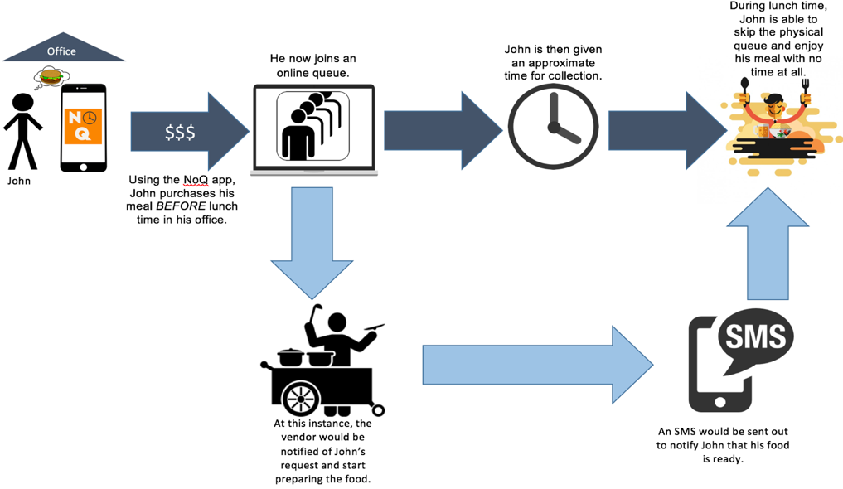

Slide 9
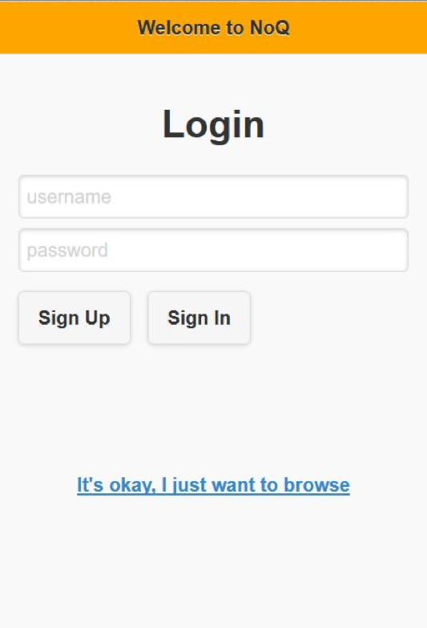
One Integrated Platform

Slide 10
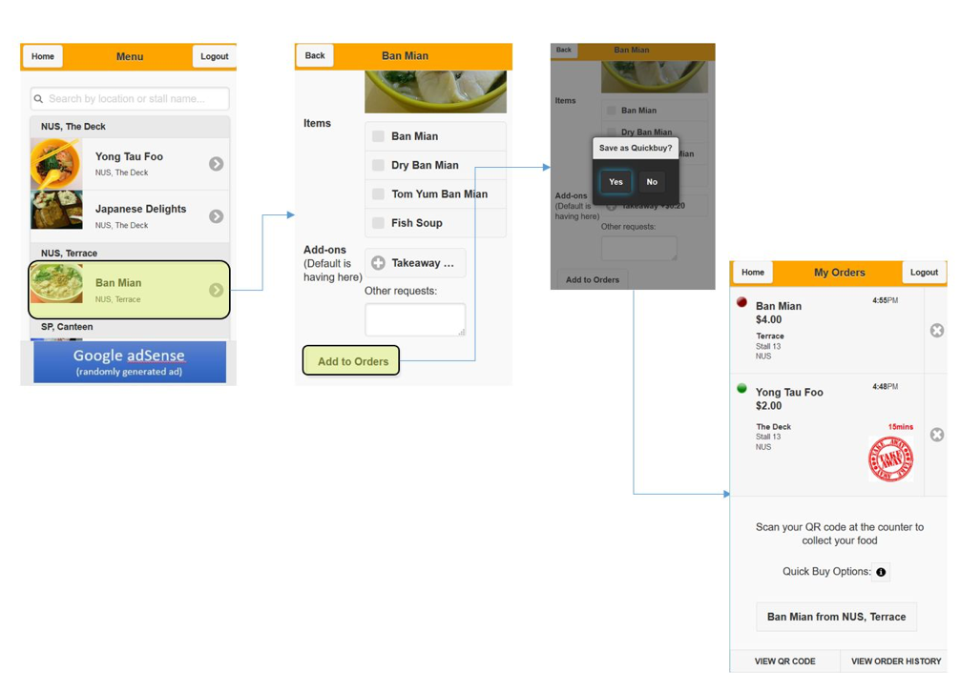
Customer Features
Order food
QuickBuy
Online payment

Slide 11
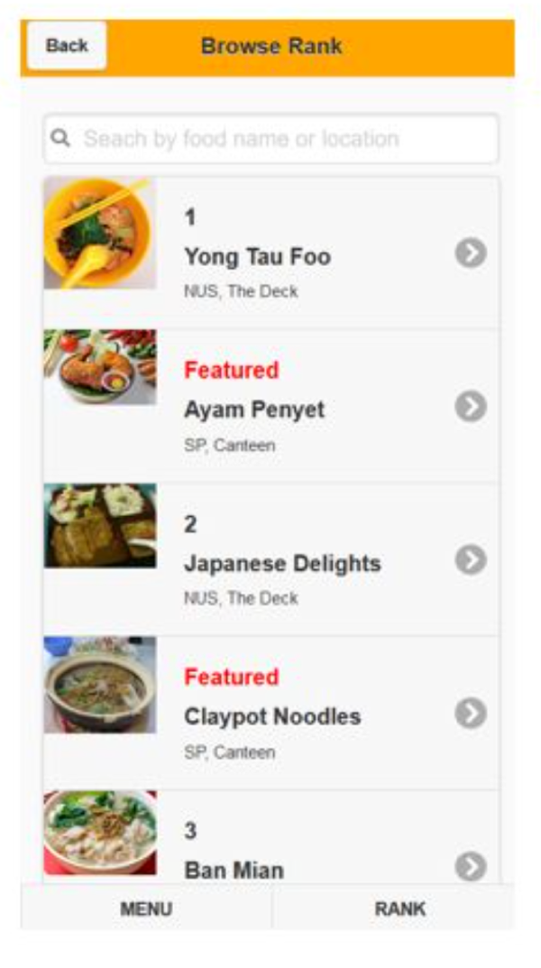
Vendor Features
Store management
Statistics summary
Store publicity

Slide 12
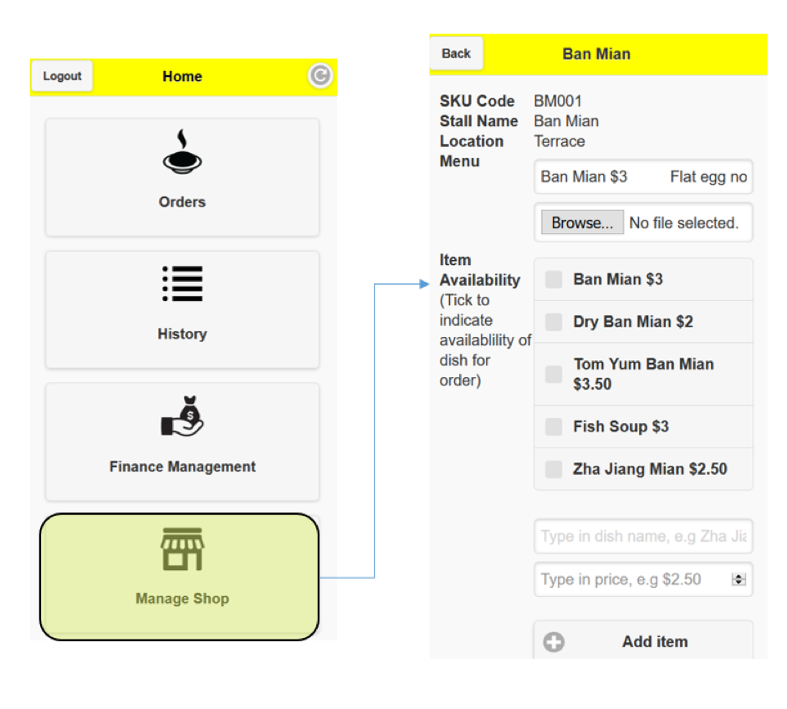
Vendor Features
Store management
Statistics summary
Store publicity

Slide 13



Competitors

Slide 14


Slide 15
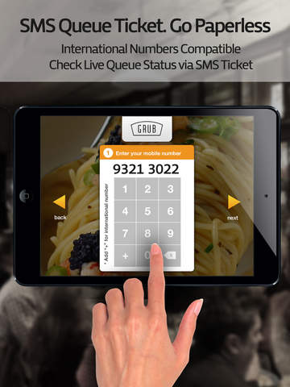

Slide 16

Market Share

Slide 17
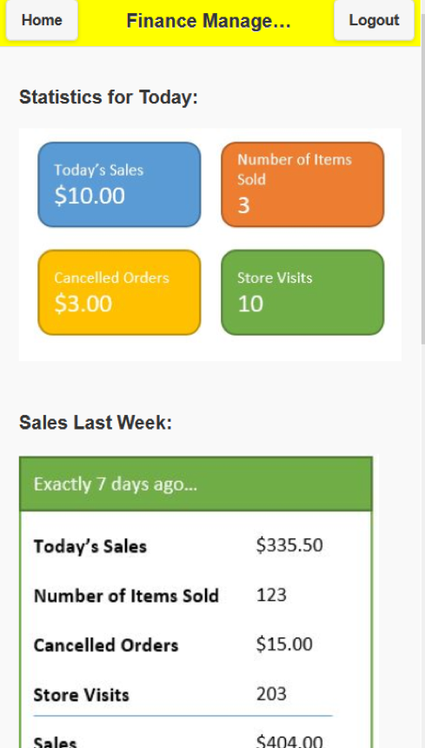
Vendor Features
Store management
Statistics summary
Store publicity

Slide 18
How do we earn money?
Commissions
Advertising

Slide 19


Commission

Slide 20

Advertising

Slide 21
Potentials
Food Industry
Other Industries
Grocery Industry
Healthcare Industry
Government Offices

Slide 22
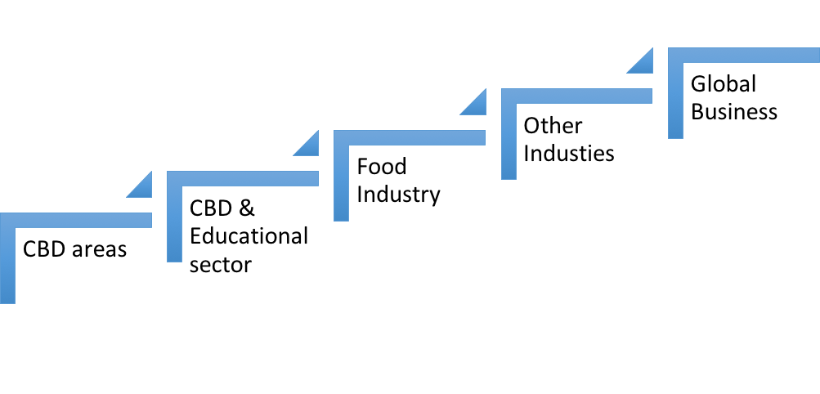
Timeline
7 Years
5 Years
1 Year
6 months
Currently

Slide 23
Conclusion

